Slide 1
Higher-Order Learning with Graph Neural Networks via Hypergraph Encodings
Raphael Pellegrin*, Lukas Fesser*, Melanie Weber
11/21/2025

Slide 2
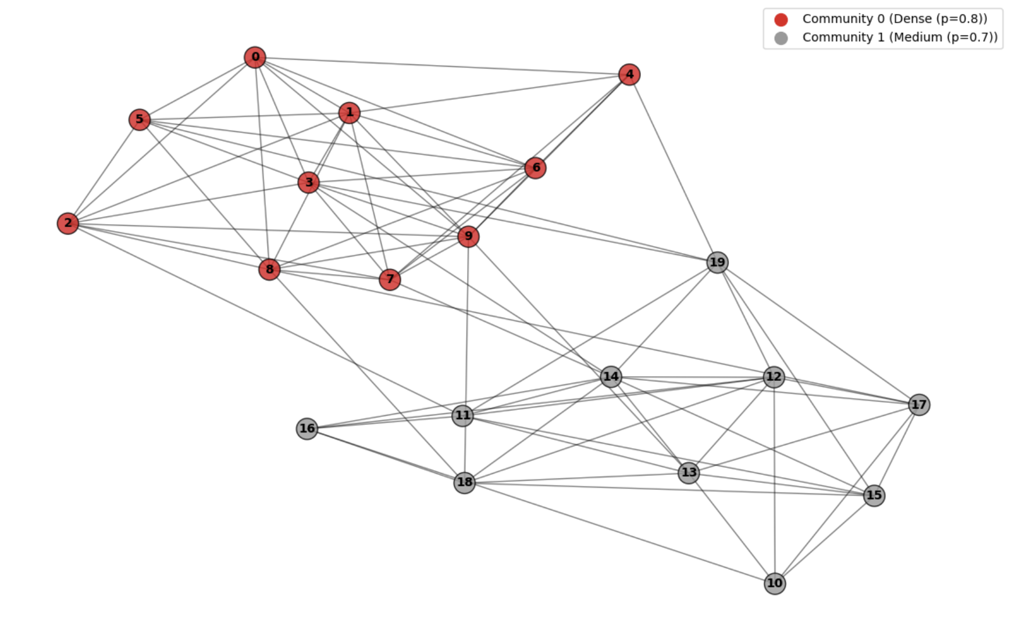
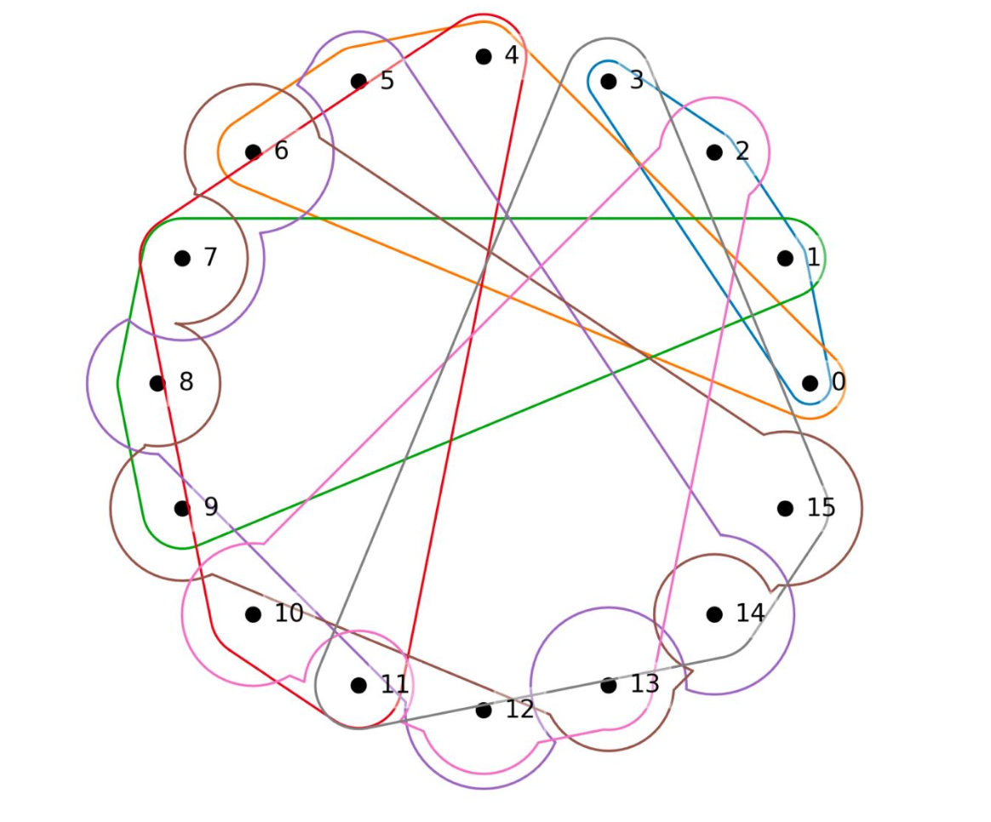
Graphs & Hypergraphs

Slide 3
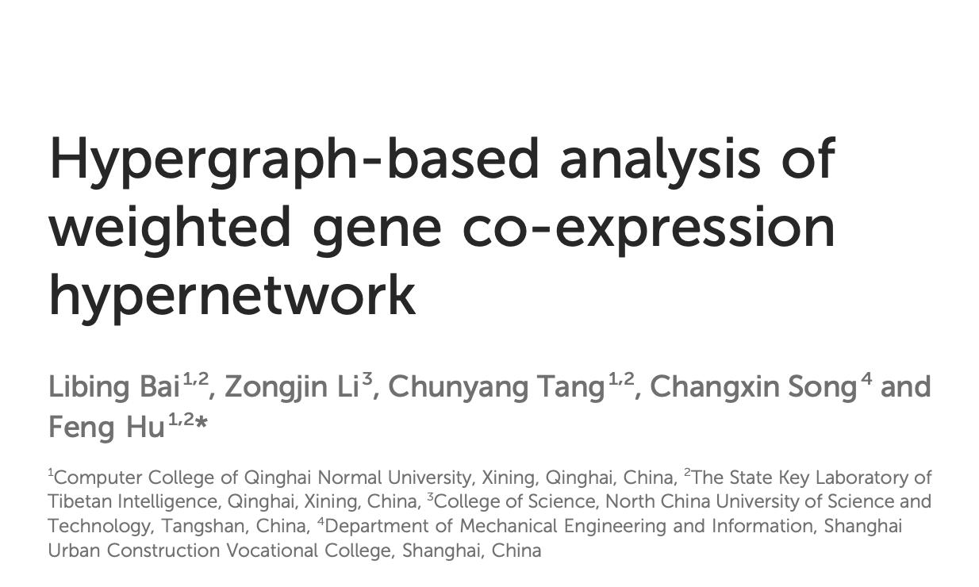
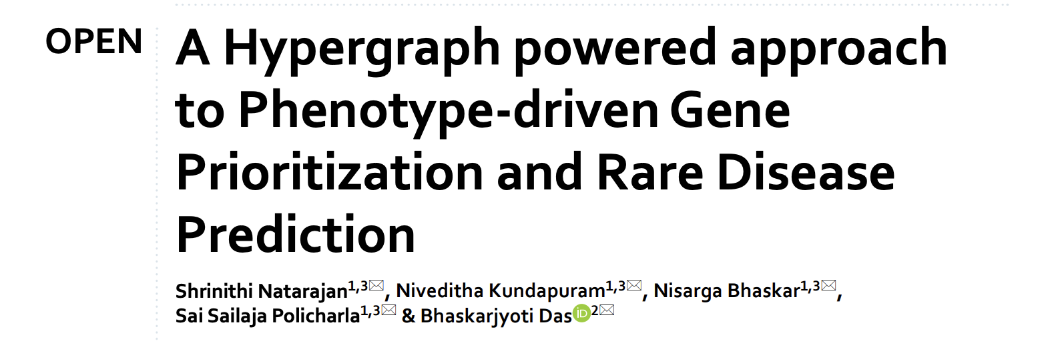
Applications

Slide 4
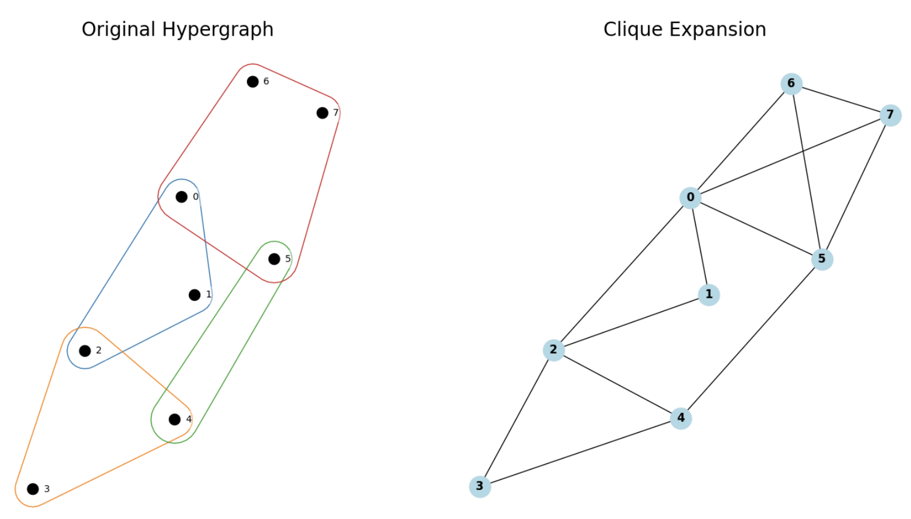
Expansions
Parametrizing hypergraphs as graphs via clique expansion
Notes:
Outline

Slide 5
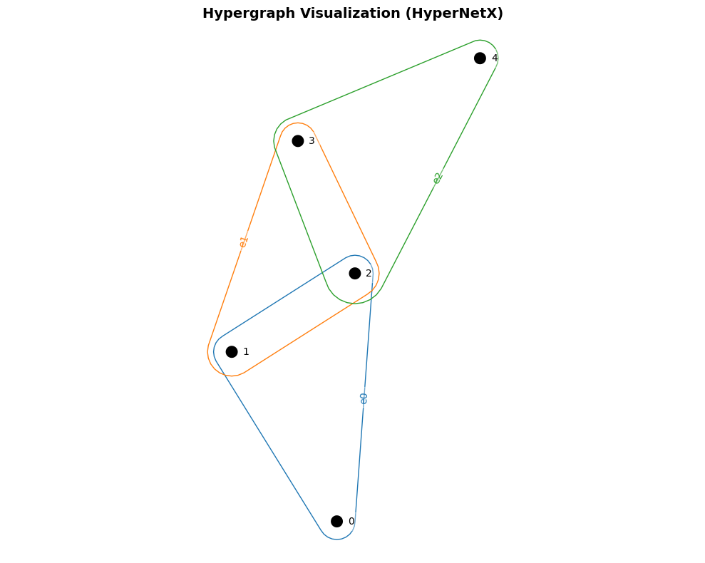
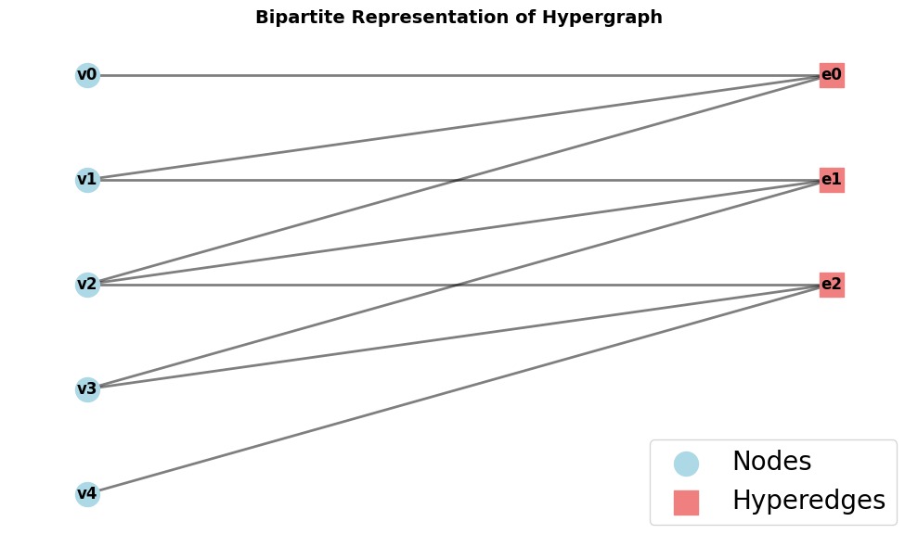
Bipartite Representations
Parametrizing hypergraphs as graphs via bipartite expansion

Slide 6
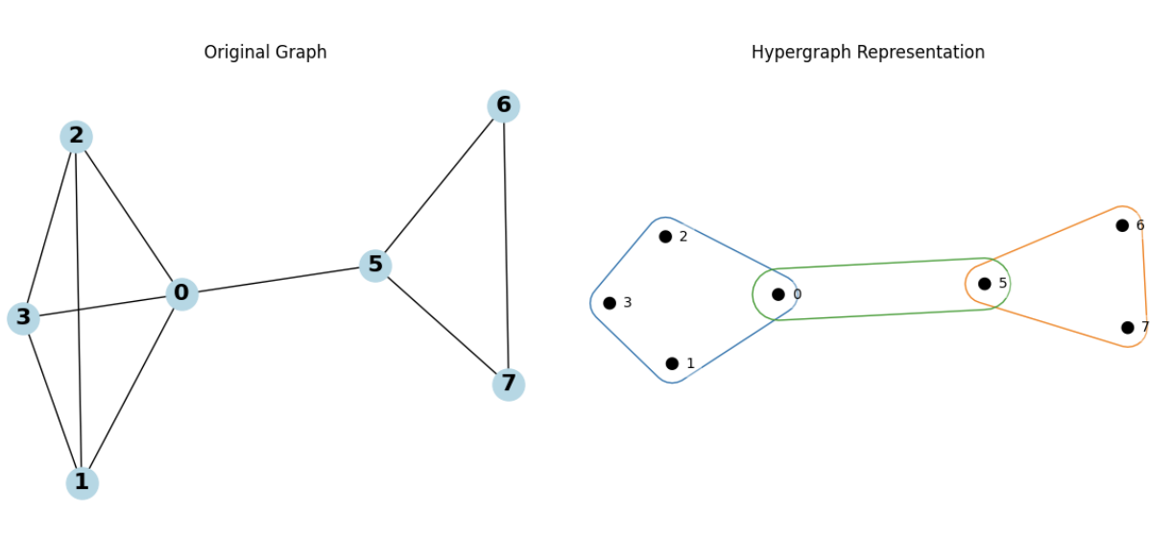
Liftings
Parametrizing graphs as hypergraphs with liftings
Notes:
Outline

Slide 7
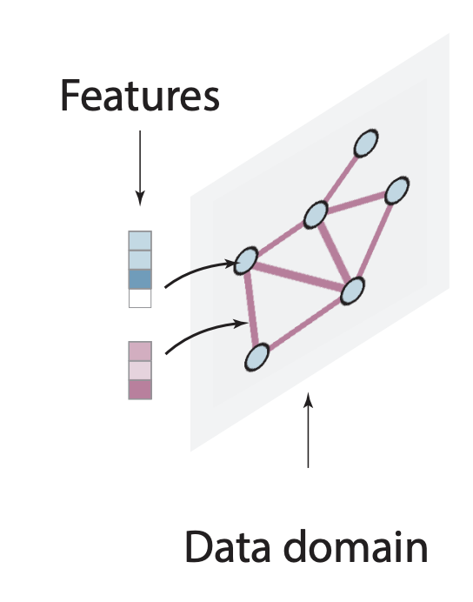
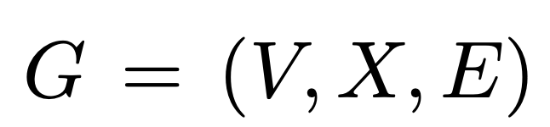
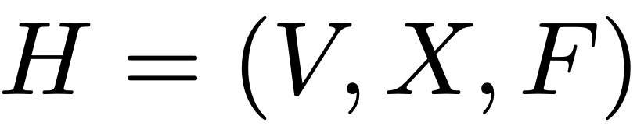
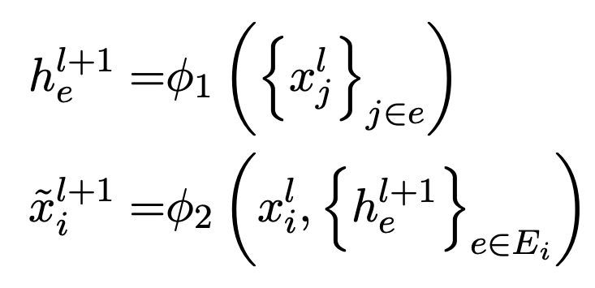
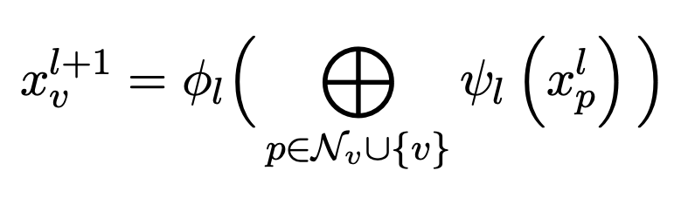
Topological Architectures
To leverage hypergraph parametrizations in relational learning, one can define message-passing on hypergraphs.
Graph Neural Networks (GNN) Hypergraph Neural Networks (HNN)
HNNs are two-phase schemes: Messages are passed from nodes to hyperedges and then back to nodes (Huang and Yang, 2021).
Notes:
Outline

Slide 8
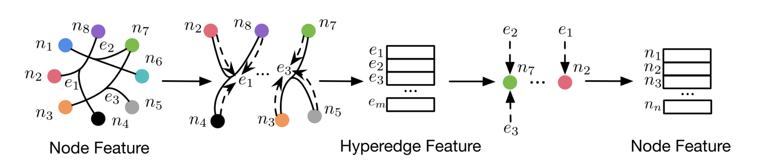
Two Phase Scheme
Feng, Y. et al. AAAI 2019.

Slide 9
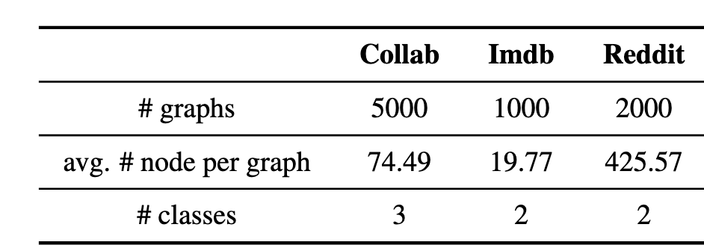
Graph Datasets – Graph Classification
Collab is a collection of ego-networks where nodes are researchers.
Labels = fields of research of the authors.
Imdb is a collection of ego-networks where nodes are actors.
Labels = genre of movies used to construct the networks.
Reddit is a collection of graphs corresponding to online discussion threads on reddit, where nodes correspond to users.
Labels = discussion-community or question answering community.

Slide 10
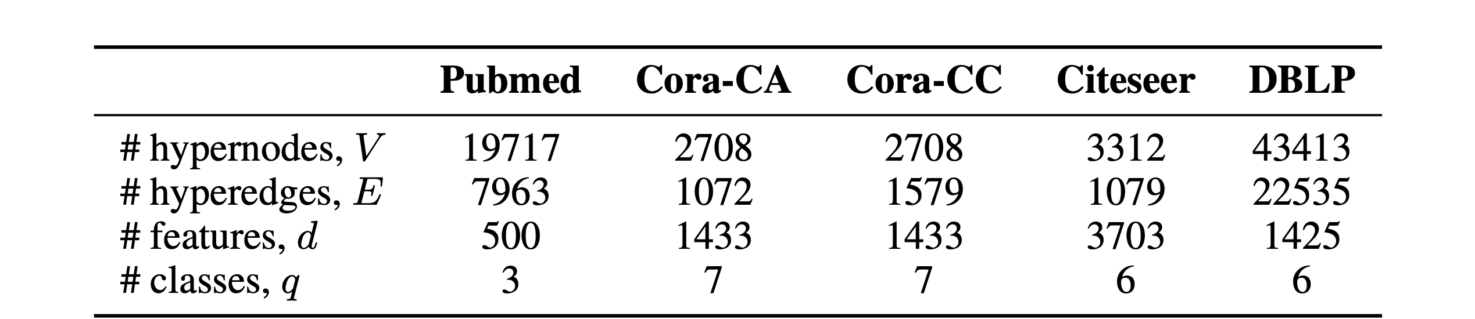
Hypergraph Datasets – Node Classification

Slide 11
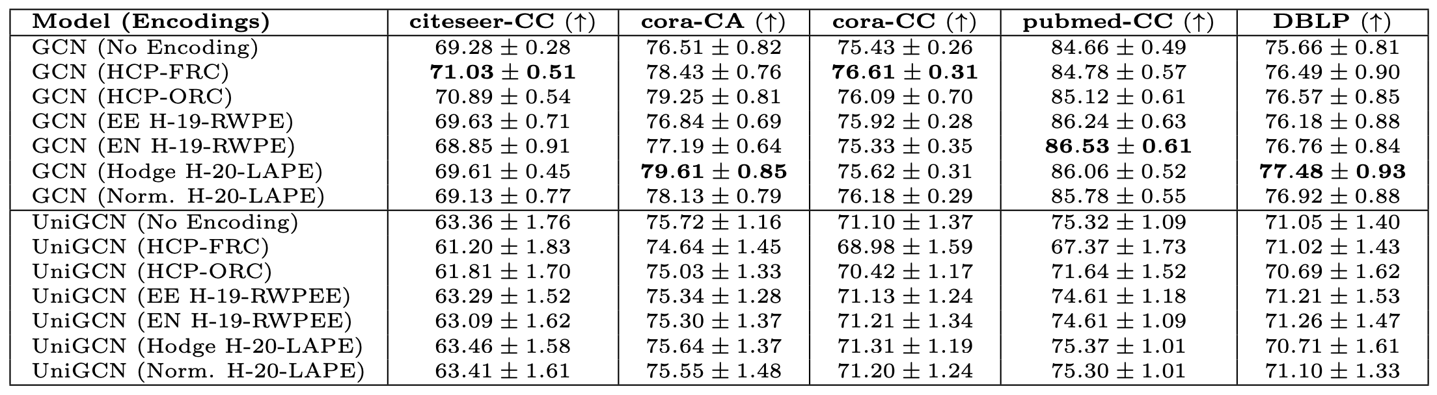
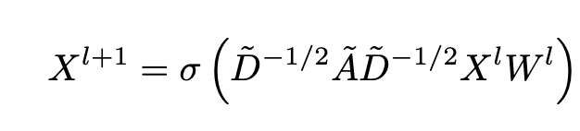
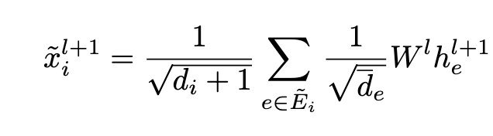
Graph-level vs Hypergraph-level architectures
GNN on clique expansion outperforms HNN
Notes:
Outline

Slide 12
Structural and Positional Encodings
Can we endow GNNs with additional structure?
Local PEs supply nodes with information about their position within local clusters or substructures, such as their distance to the centroid of their community.
Global PEs convey a node’s overall position within the entire graph.
SEs capture structural information, such as pair-wise node distances, node degrees.
Notes:
Outline

Slide 13
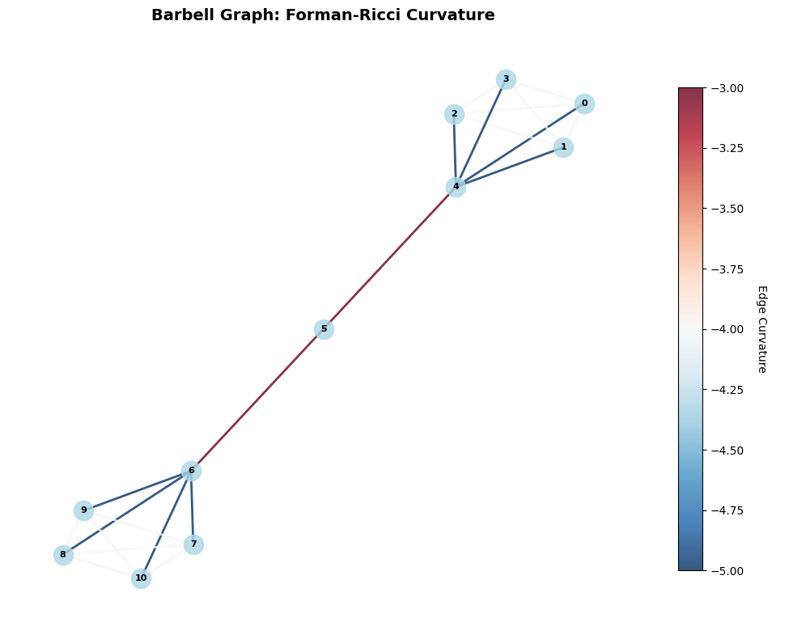
Enhancing Representational Power
Can we endow GNNs with additional structure?
Data Augmentation: Encodings
Structural (SE) and Positional (PE) encodings endow GNNs with information that it cannot learn on its own.
Graph Laplacian (Global PE)
Substructure counts (Local SE)
Node degrees (Local SE)
Discrete curvature (Local SE)
Randow walks (Global PE)
Beyond Message-Passing GNNs: Leveraging higher-order structure
[Morris et al., AAAI 2019]: Message-passing between sets of nodes. More expressive, but computationally expensive.
Topological architectures, e.g., hypergraph neural networks.
Notes:
Outline

Slide 14
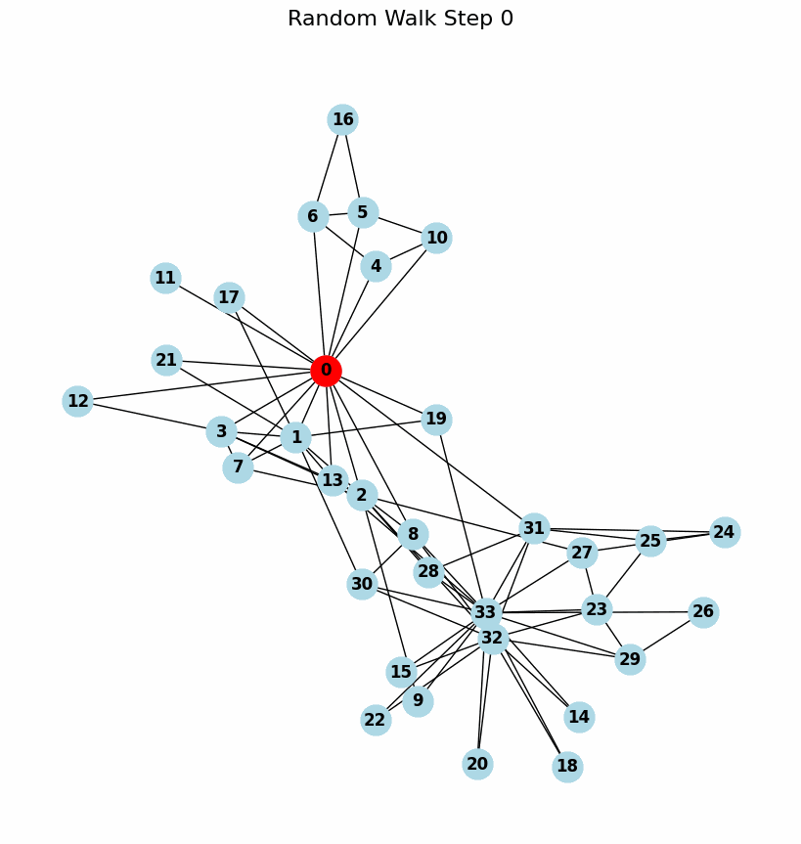
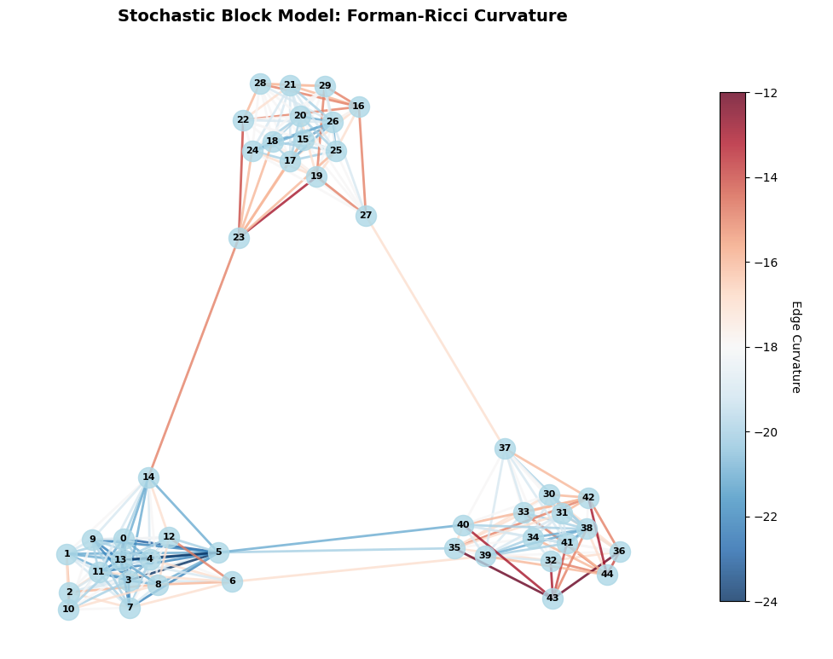
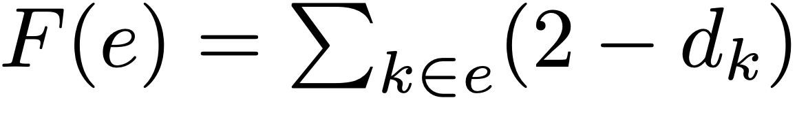
Illustration of graph RW and Curvature

Slide 15
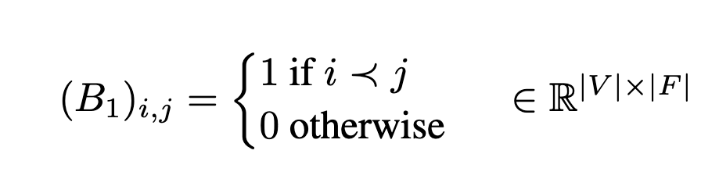
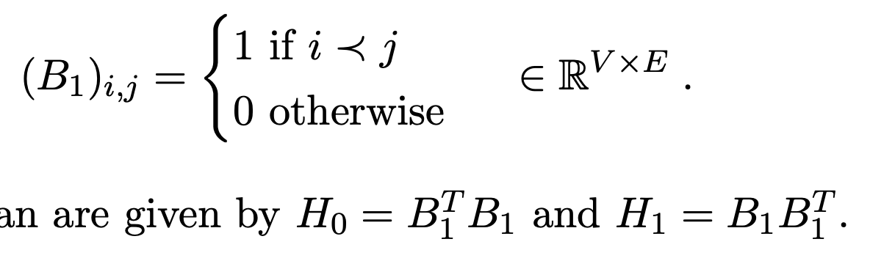
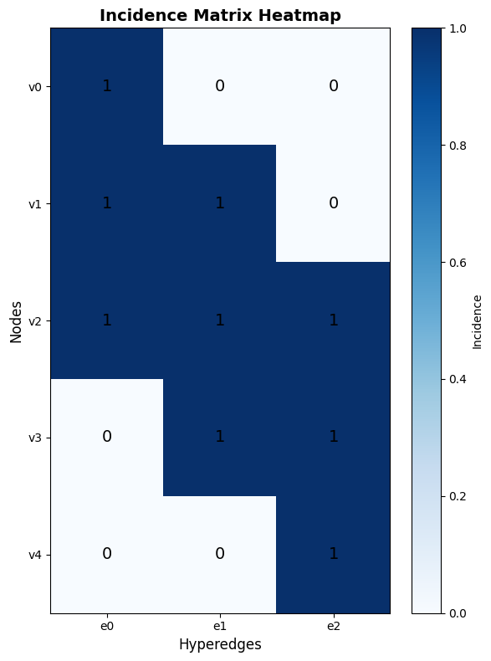
Hypergraph-level Encodings – H-LAPE
How to best leverage higher-order relational information?
Augment graph with structural information, computed at the hypergraph-level.
Eigenvectors of the Hodge Laplacian (H-LAPE)
Notes:
Outline

Slide 16
Incidence Matrix
Notes:
Outline

Slide 17
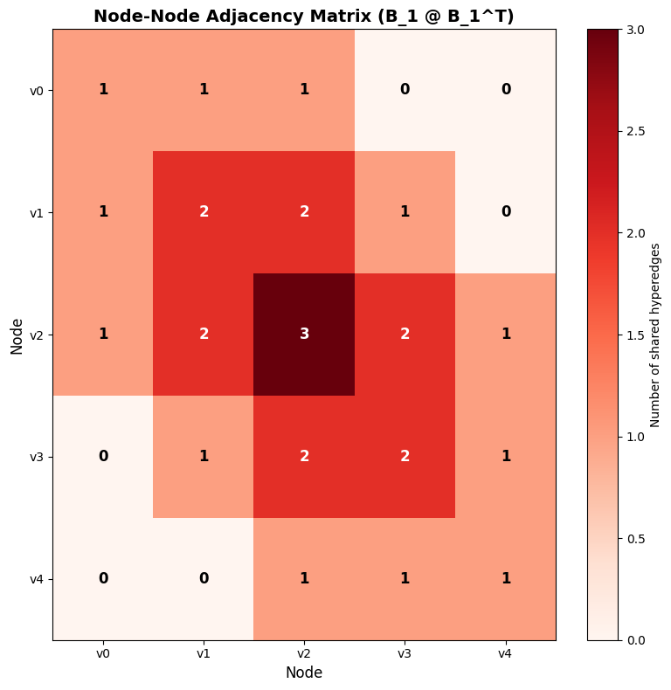
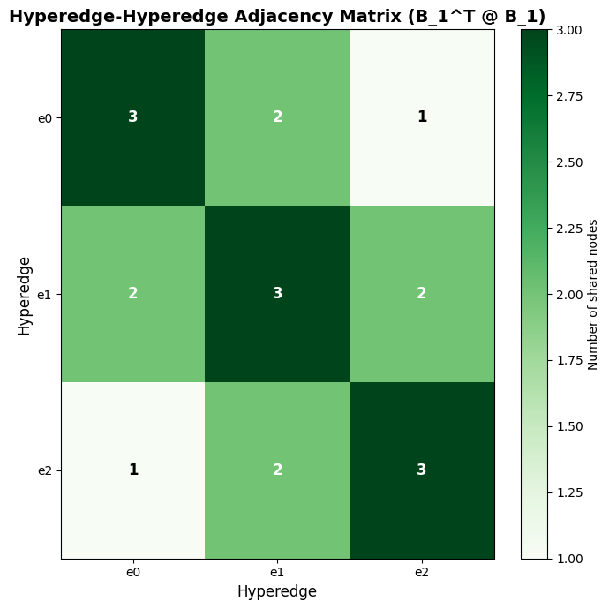
Laplacians
Notes:
Outline

Slide 18
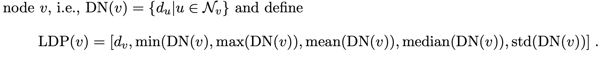
Hypergraph-level Encodings – H-LDP
How to best leverage higher-order relational information?
Augment graph with structural information, computed at the hypergraph-level.
2. Local Degree Profiles (H-LDP)
Multi-set of node degrees in each node 1-hop neighborhood.
Notes:
Outline

Slide 19
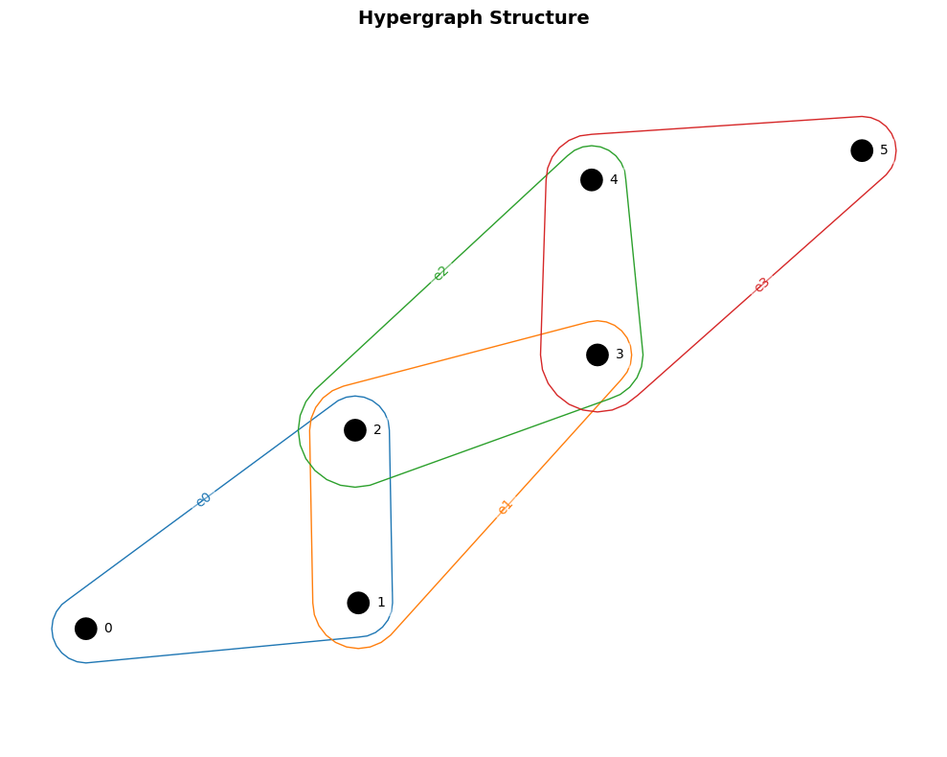
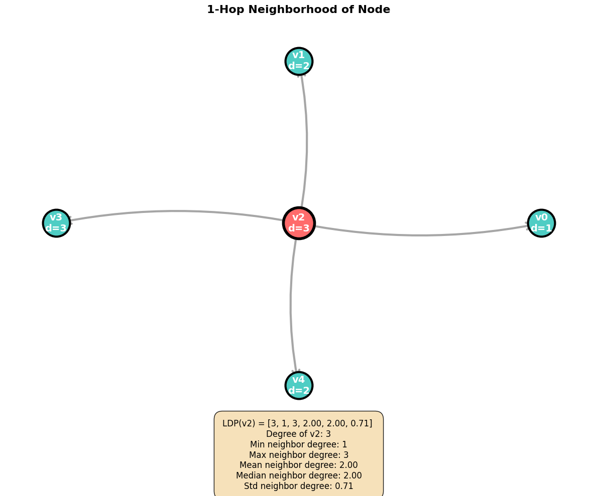
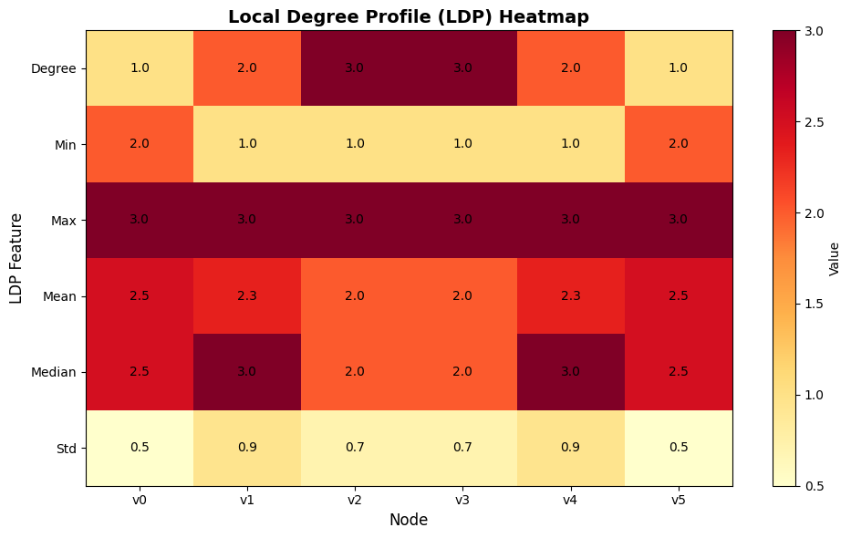
Hypergraph-level Encodings – H-LDP
Notes:
Outline

Slide 20
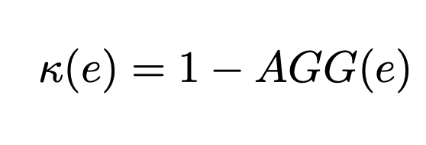
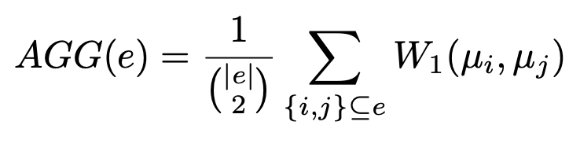
Hypergraph-level Encodings – H-LCP
How to best leverage higher-order relational information?
Augment graph with structural information, computed at the hypergraph-level.
3. Local Curvature Profiles (H-LCP)
Implement LCP as before, but with hypergraph-level curvature (e.g., Coupette et al., ICLR 2023).
Notes:
Outline

Slide 21
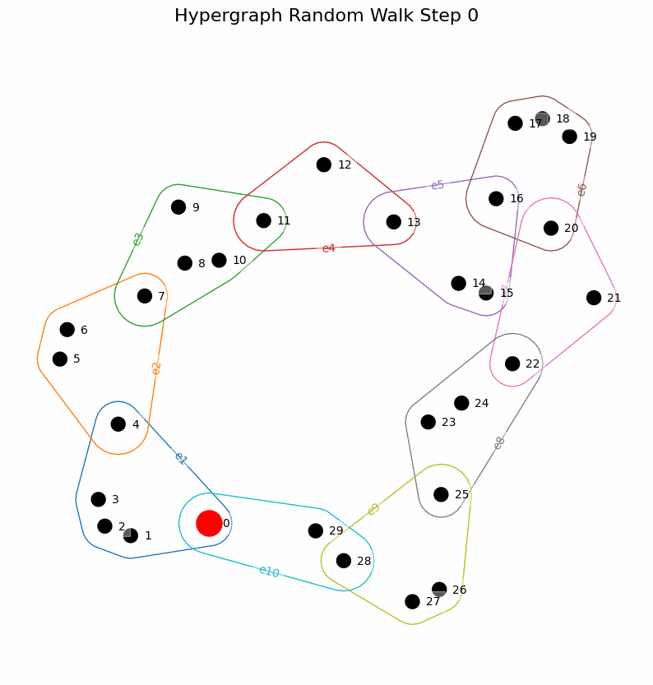
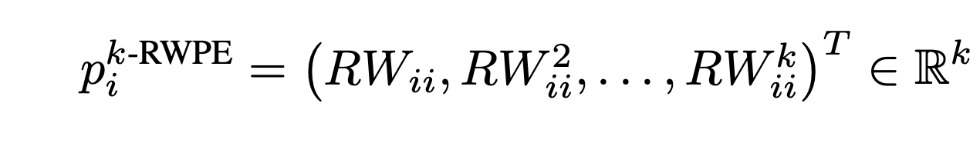
Hypergraph-level Encodings – H-RWPE
How to best leverage higher-order relational information?
Augment graph with structural information, computed at the hypergraph-level.
4. Random Walks Positional Encodings (H-RWPE)
Notes:
Outline

Slide 22
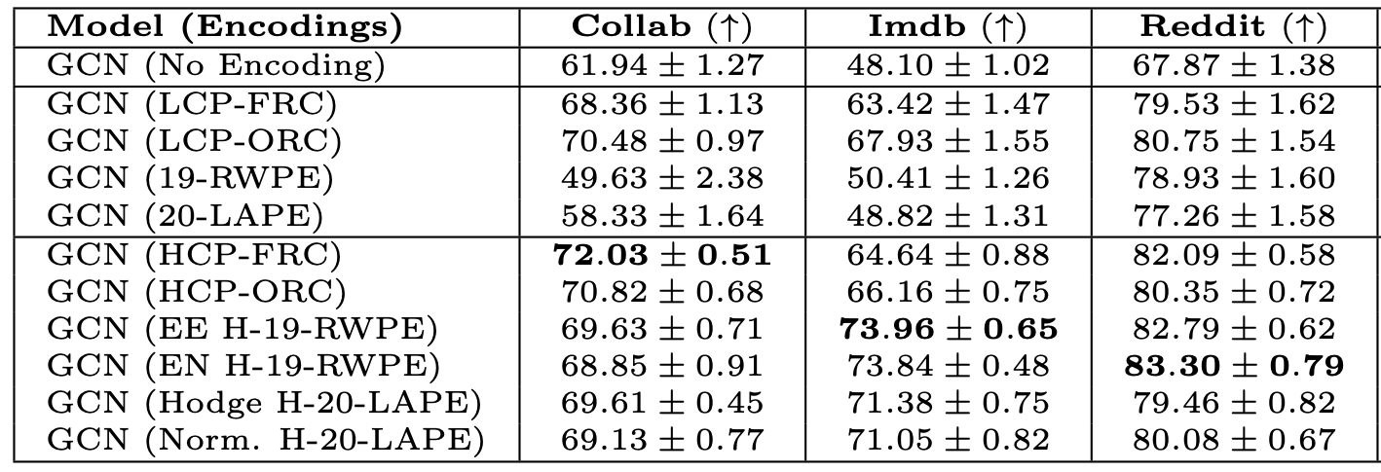
Hypergraph-level Encodings
H-Encodings provide additional boost to GNNs
GNN with G-Encodings vs. H-Encodings
Notes:
Outline

Slide 23
Representational Power of GNNs
What can Graph Neural Networks learn?
GNNs learn representations of graphs, their utility can be measured via expressivity:
Does the GNN map two graphs to the same representation, if (and only if!) they are topologically identical?
Graph Isomorphism Testing
Decide, whether two graphs are topologically identical (“isomorphic”). No efficient algorithm.
Two graphs with adjacency matrices and node attributes are isomorphic, iff there exists a permutation matrix , such that
.
One way to measure the representational power of GNNs is to understand for which types of graphs they can solve Graph Isomorphism Testing.
Notes:
Outline

Slide 24
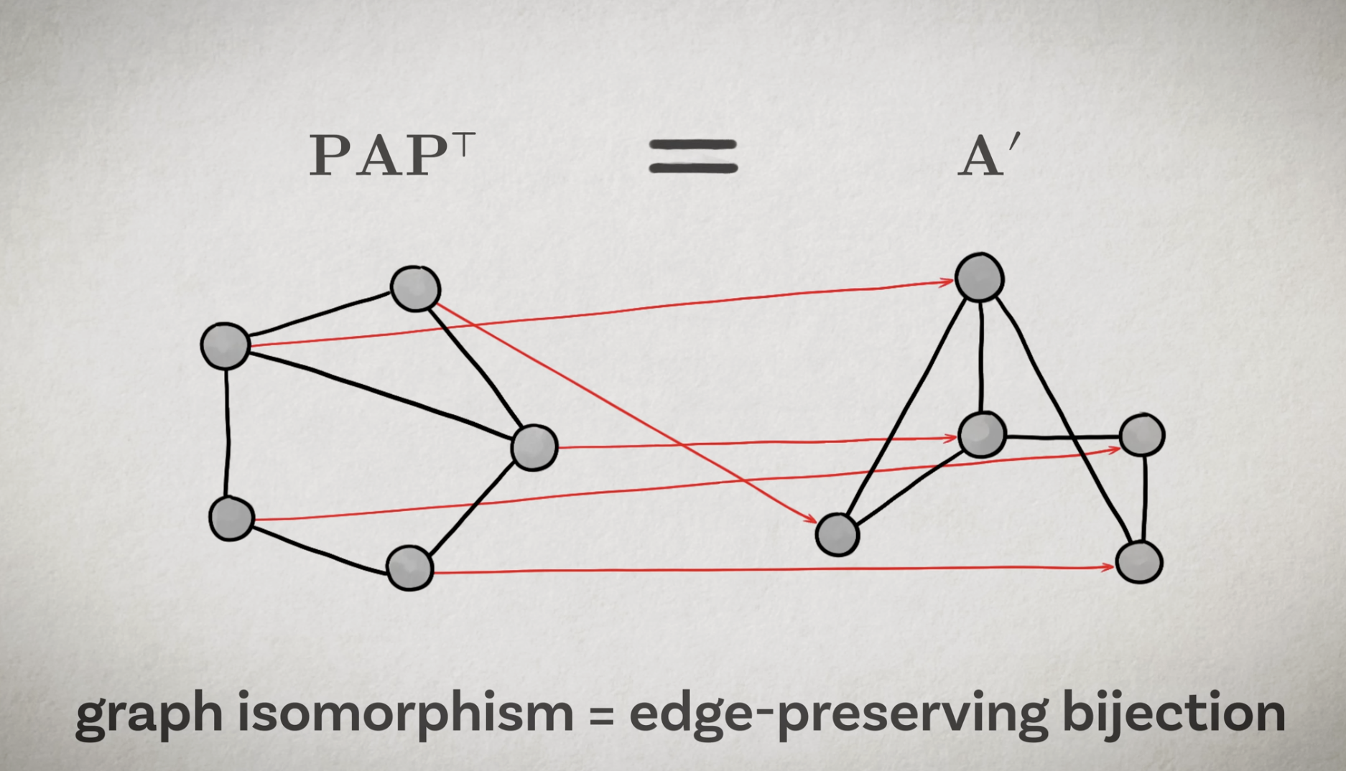
Graph isomorphism
Bronstein, M. ICLR 2021 Keynote.

Slide 25
Weisfeiler-Leman Test
GNN on clique expansion outperforms HNN
WL is an isomorphism test relying on colour refinement.
In each iteration, WL assigns colour to each node by aggregating information from its neighbouring nodes’ states.
This process continues until convergence, resulting in a multiset of node states representing the final graph representation.
WL effectively identifies most non-isomorphic graphs, but may fail in certain simple graphs.

Slide 26
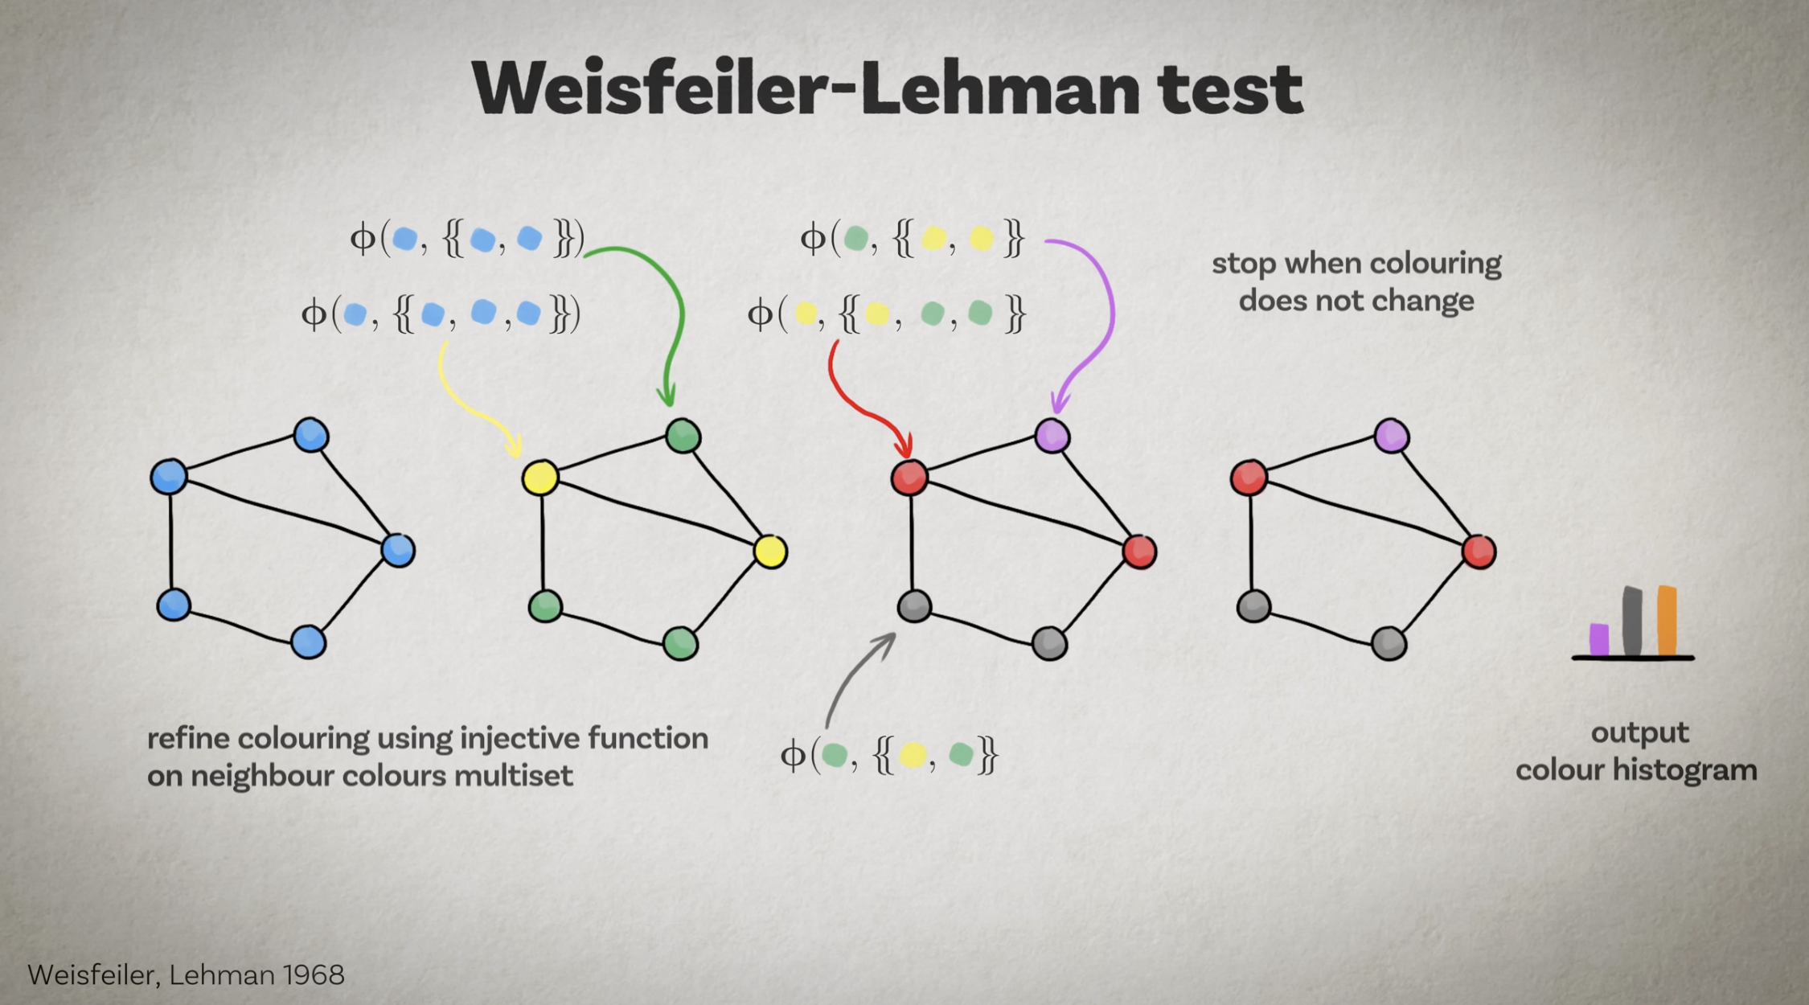
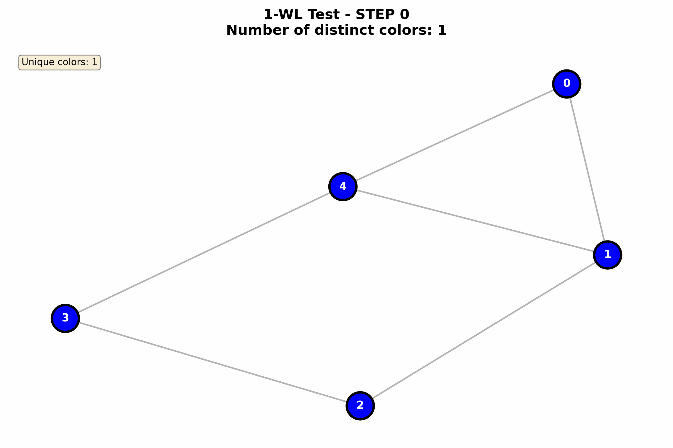
Weisfeiler-Leman Test
Bronstein, M. ICLR 2021 Keynote.

Slide 27
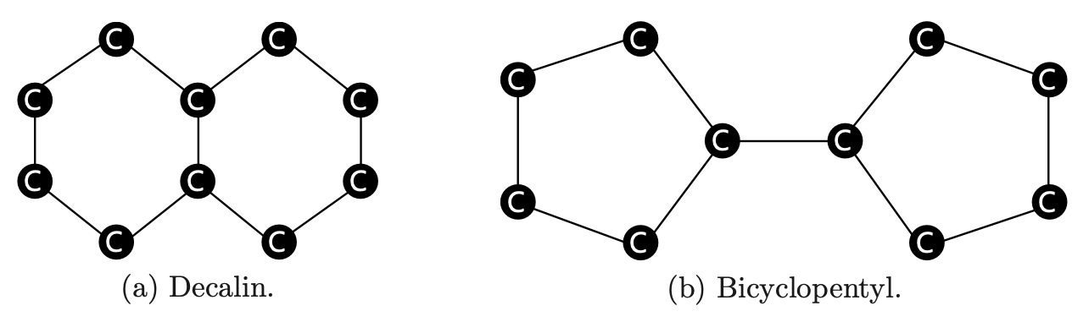
Weisfeiler-Leman Test
The Weisfeiler-Lehman (WL) Test (1968) can distinguish a large class of graphs but has notable limitations:
Regular graphs.
Not isomorphic.
Not regular.
Not isomorphic.
Notes:
Outline

Slide 28
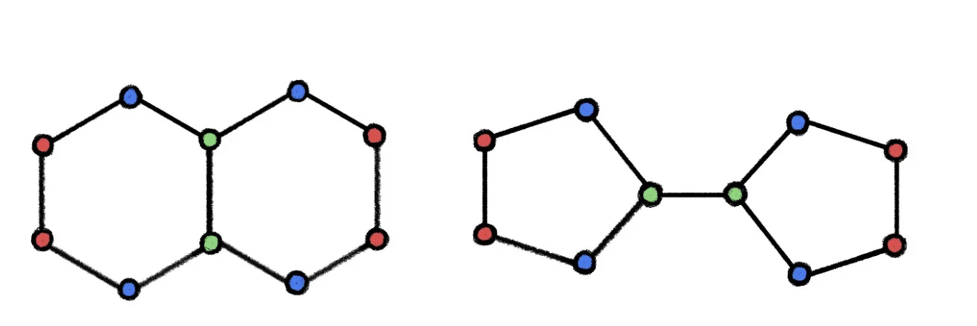
Weisfeiler-Leman Test
Not regular.
Not isomorphic.
Notes:
Outline

Slide 29
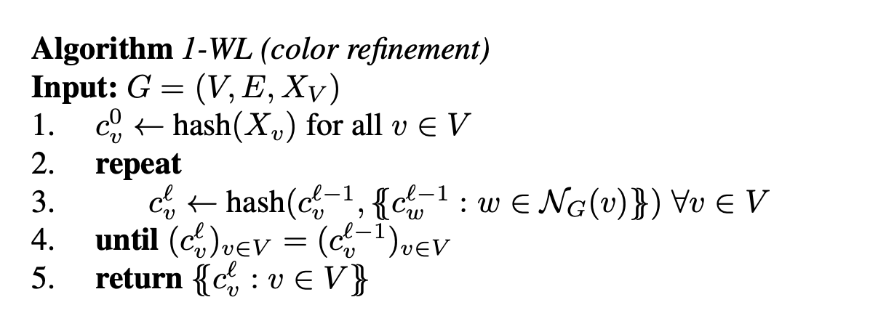
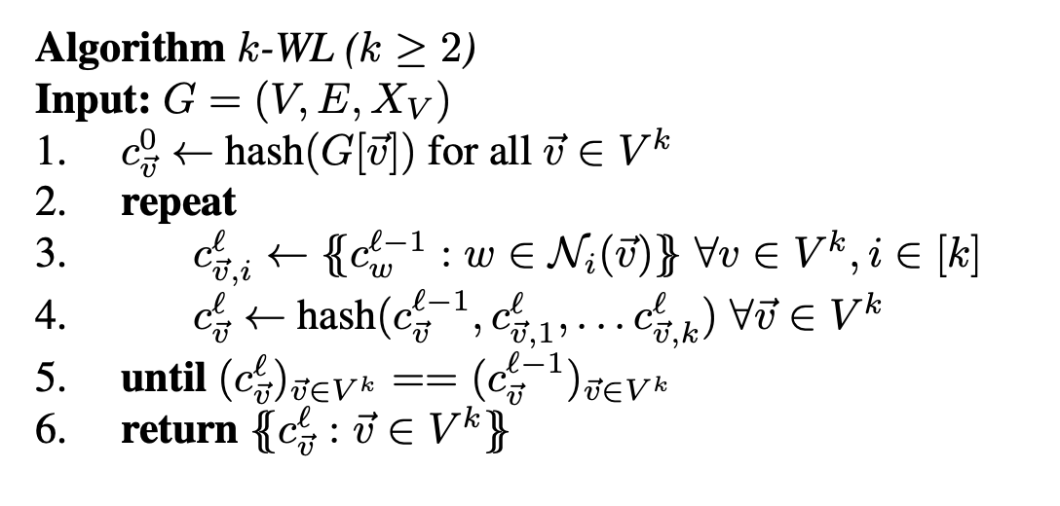
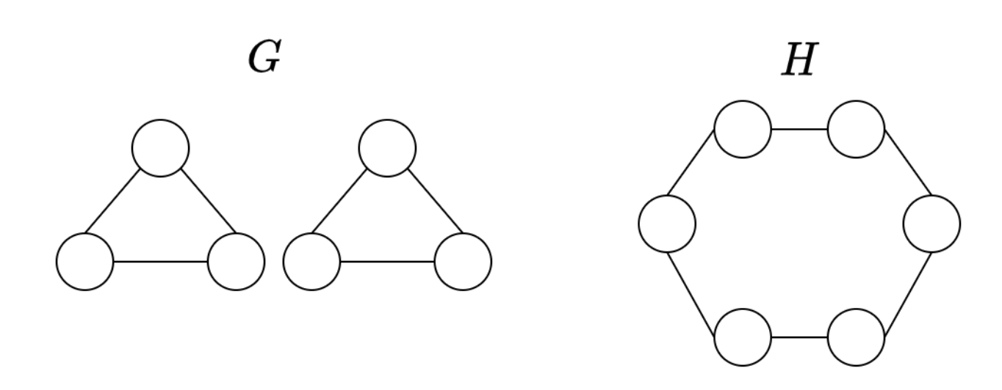
k-WL and FWL
k-WL consider k-tuples of nodes.
1 and 2-WL indistinguishable.
Huang, T., Soledad V. IEEE 2021.

Slide 30
Graph Isomorphism Testing
WL test can an solve Graph Isomorphism Testing for a large class of graphs, with notable exceptions.
GNNs are not more powerful than the 1-WL test.
Xu et al. (ICRL 2019), Morris et al. (AAAI 2019):
Let be two non-isomorphic graphs. If the WL test cannot distinguish them, then there is no MPGNN that can distinguish them.
There exist MPGNNs (e.g., GIN) that are as powerful as the WL test.
Notes:
Outline

Slide 31
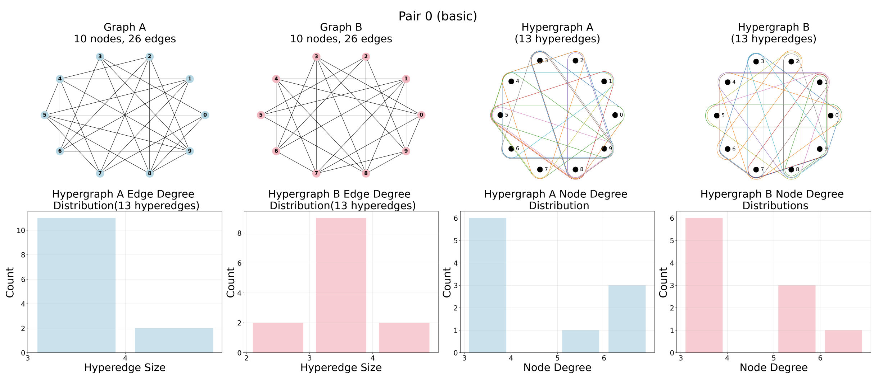
Hypergraph-level Encodings
H-Encodings are more expressive than G-Encodings
Notes:
Outline

Slide 32
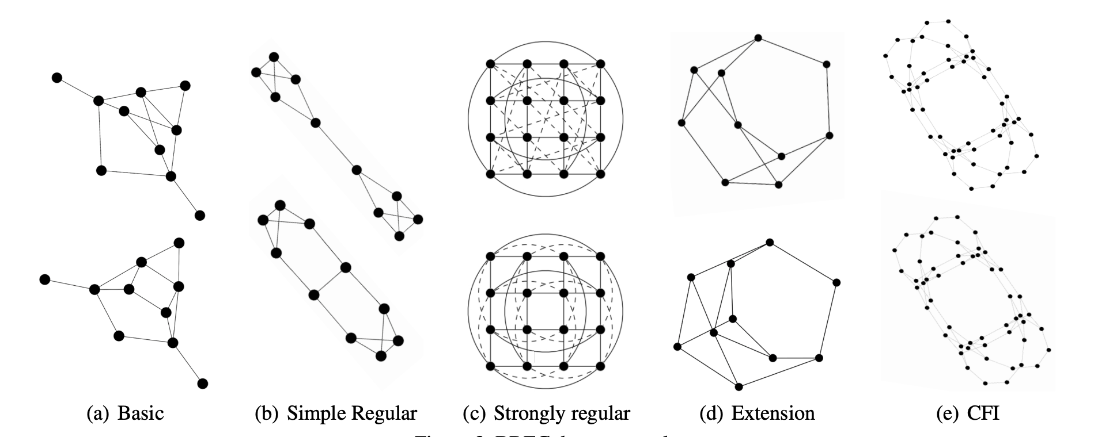
BREC datasets
The BREC dataset consists of 400 graph pairs, 1-WL to 4-WL-indistinguishable, divided into 5 categories.
Wang, Y., Zhang, M. (2023).

Slide 33
Example pair from BREC – Strongly Regular
Non-isomorphic!

Slide 34
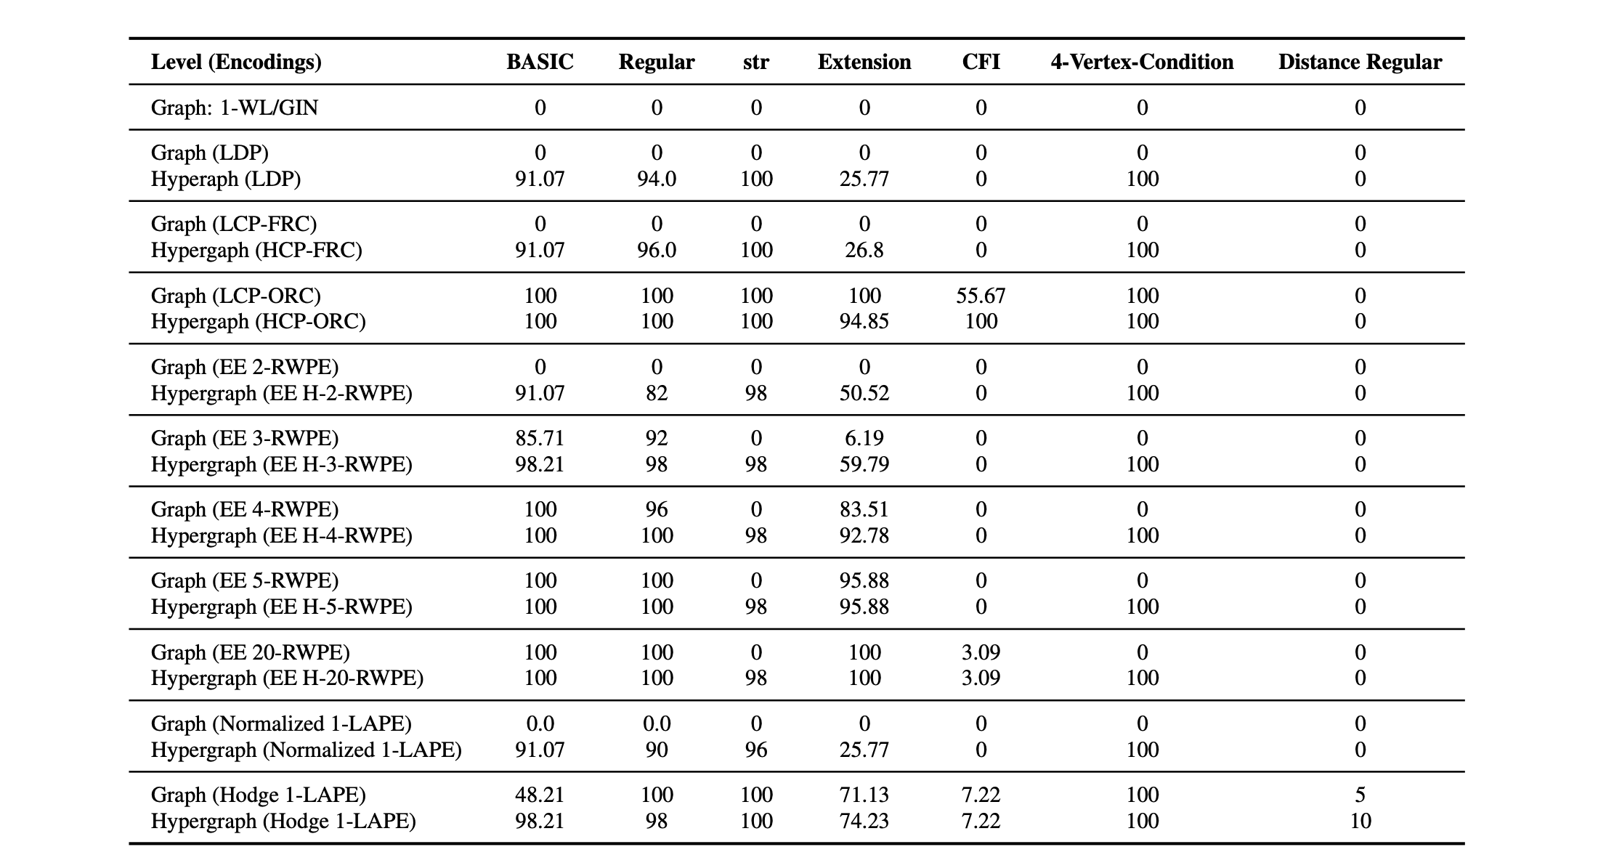
Comparison of G-encodings an H-encodings on BREC

Slide 35
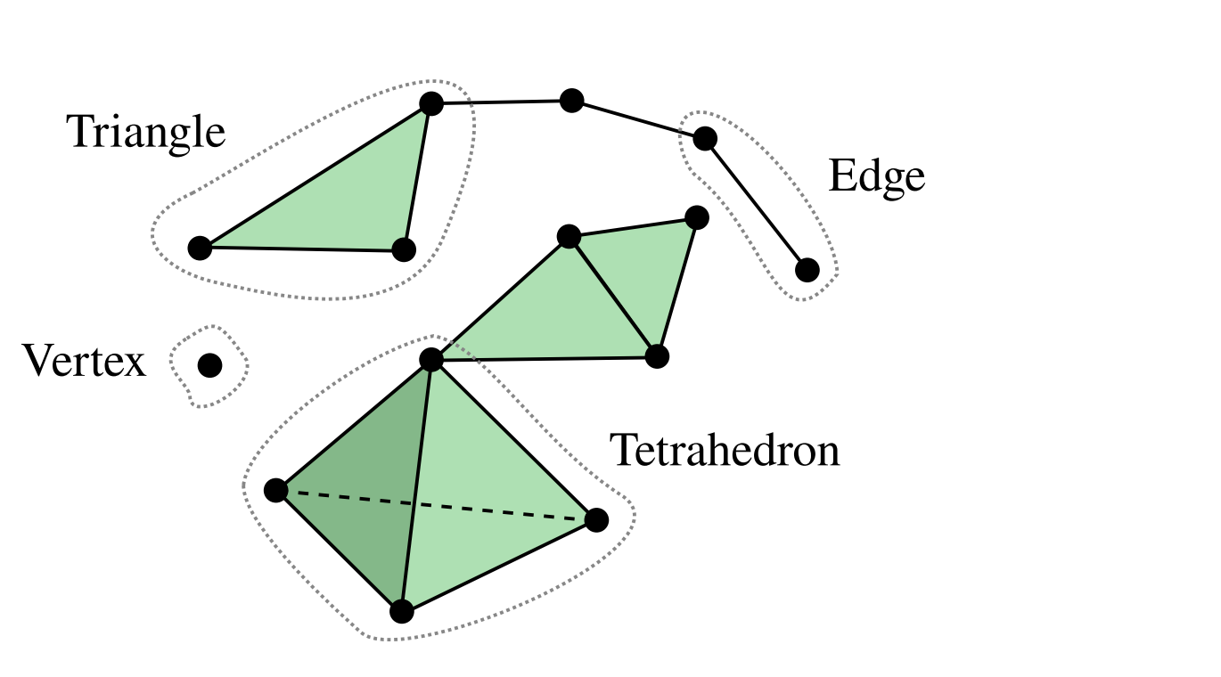
Simplicial Complexes
Possible extensions to other domains!
Einizade, A. et al. 2025. arXiv:2503.12919.

Slide 36
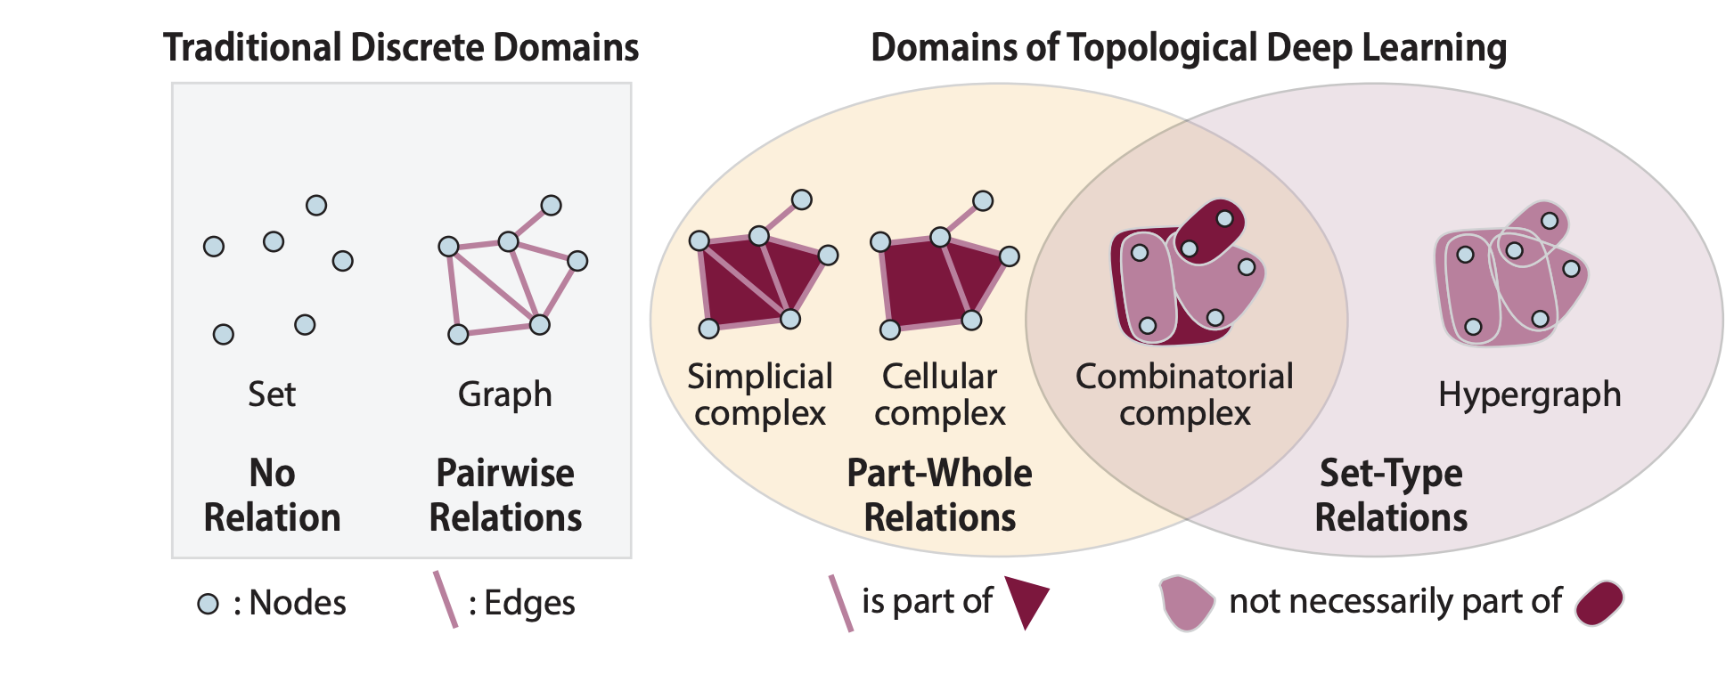
Other Domains
Papillon, M. et al. 2024.

Slide 37
Thank you!

Slide 38
Questions
Why do HNNs underperform expansions + GNNs?
Why do HNNs not benefit from hypergraph encodings?

Slide 39

Overview of Architectures

Slide 40

MLP

Slide 41

Graph-level Encodings

Slide 42

Message Passing
Bronstein, M. ICLR 2021 Keynote.

Slide 43

GAT
Velickovic, P. et al. 2017. arXiv:1710.10903.

Slide 44

Rook and Shrikhande Graphs - 1-WL indistinguishable
The Rook graph and the Shrikhande graph. Those two non-isomorphic graphs can be hard to distinguish: they are both srg(16,6,2,2) and are isospectral.
every two adjacent vertices have 2 common neighbours, and
every two non-adjacent vertices have 2 common neighbours.

Slide 45


Random Walks on Hypergraphs – Equal Nodes

Slide 46



Random Walks on Hypergraphs – WE and EE

Slide 47

Random Walks on Hypergraphs – EN, EE and WE
Coupette, A. et al. ICLR 2023.

Slide 48

Ollivier-Ricci Curvature
Example networks from the mutag, enzymes, imdb, and proteins datasets. The bottom row shows the same example networks with their edges colored according to their ORC values.
Fesser, L., Weber, M. 2023. arXiv:2311.14864.

